Slide 1


Slide 2
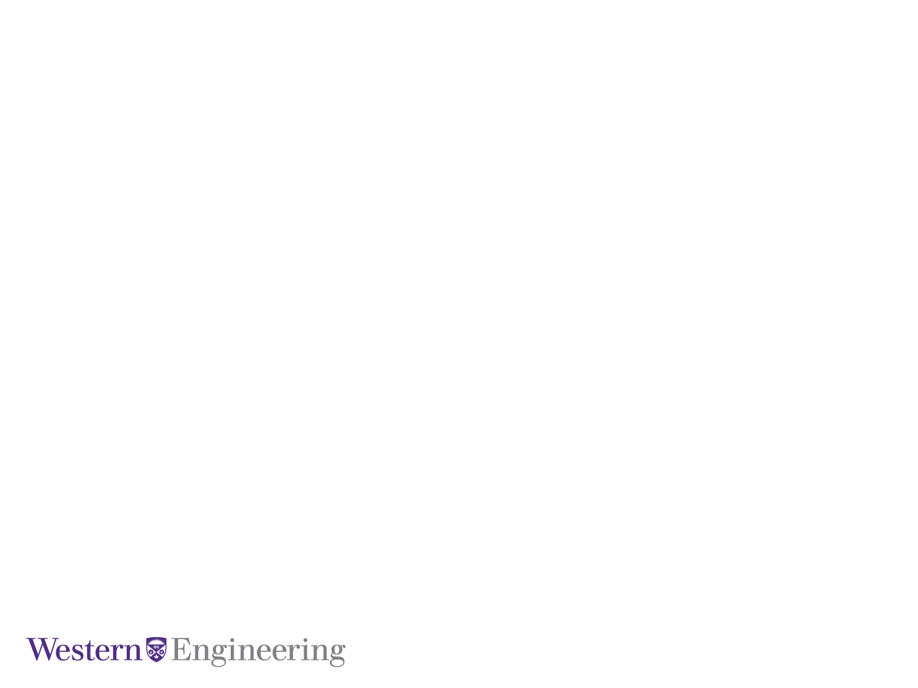
Integrating Explainability into Reinforcement Learning for Autonomous Vehicle Navigation in Simulated Environments
April 5, 2024
By:
Fatemeh Dehrouyeh &
Jifar Mekonnen

Slide 3
April 5, 2024
Today’s Agenda
Introduction
Related Works
Methodology
Environment
Reward
Agents
Results
Conclusion

Slide 4
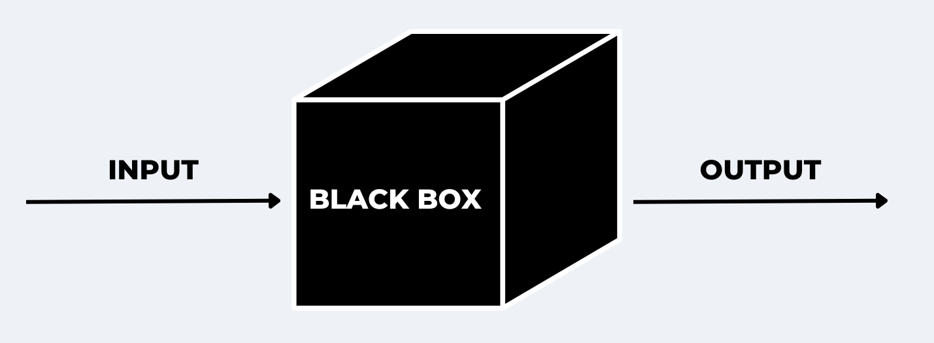
Introduction: Explainability
More transparent outputs
No black-box anymore!
Global Interpretability clarify the entire logic of a model that leads to various outcomes
Local Interpretability explains the rationale behind a specific decision.
SHapley Additive exPlanations (SHAP)

Slide 5
Related Works
 | Liessner et al | L. He et al.
Agent Used | Deep deterministic policy gradient (DDPG) | Twin Delayed DDPG (TD3)
Environment | OpenAI Gym LongiControl | Unmanned Aerial Vehicles (UAV) navigation
Explainablity method | SHapley Additive exPlanations (SHAP) | SHAP (DeepSHAP) + Class Activation Map (CAM)
Time of information extraction | Post-hoc | Post-hoc
Scope of explanation | Local | Local + Global

Slide 6




Environment
Lunar-lander (from OpenAI gym Box2D)
Action space: 4 discrete actions
do nothing
fire left engine
fire main engine
fire right engine
Observation space: 8-d vector
$$(x, y, \frac{dx}{dt}, \frac{dy}{dt}, θ, ω, l1, l2)$$
Notes:
s

Slide 7


Reward
Reward is:
Increased
moving closer to the landing pad
moving slower
leg in contact with the ground. (+10)
landing safely (+100)
Decreased
moving further to the landing pad
moving faster
the more the lander is tilted
firing side engine (-0.03)
firing main engine (-0.3)
crashing (-100)
An episode is a solution if the total reward is greater than 200 points.

Slide 8
Agents
Hyperparameters for the agents:
DQN
gamma = 0.99
learning rate = 6.3e-4
batch size = 128
replay buffer size = 50000
A2C
gamma = 0.995
learning rate = 8.3e-4
PPO
gamma = 0.999
learning rate = 3e-4

Slide 9
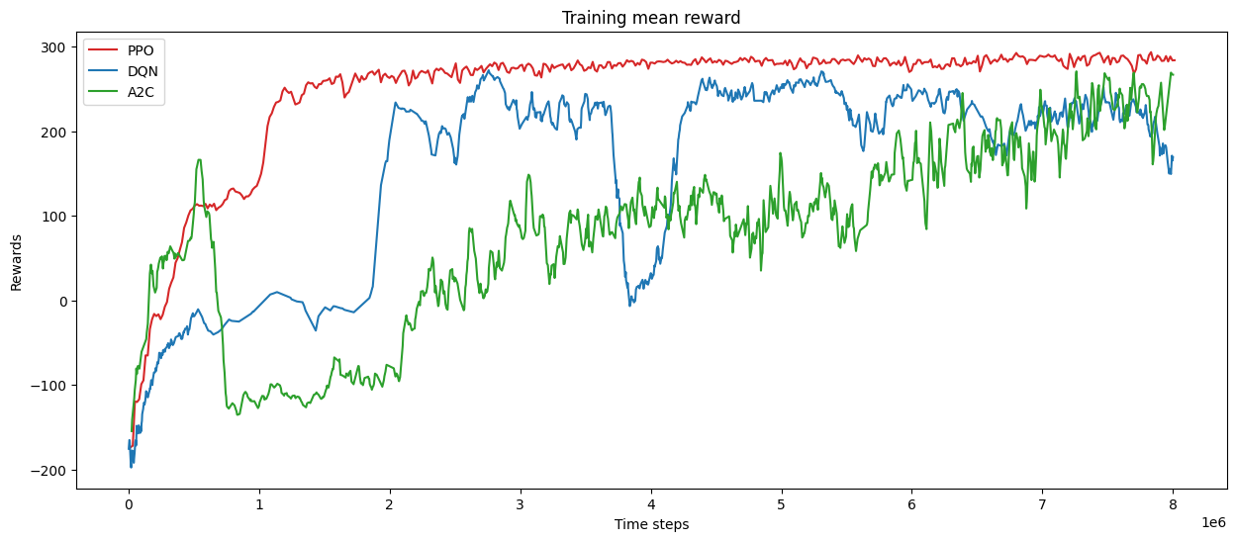
Results: Mean episode reward
Presentation Title Here

Slide 10
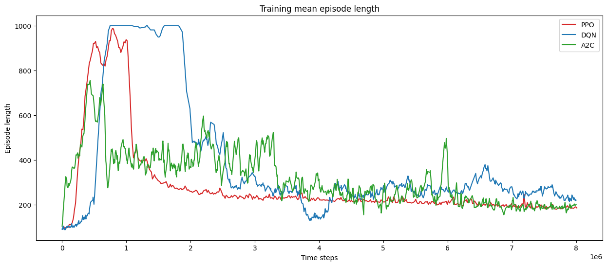
Results: Mean episode length

Slide 11
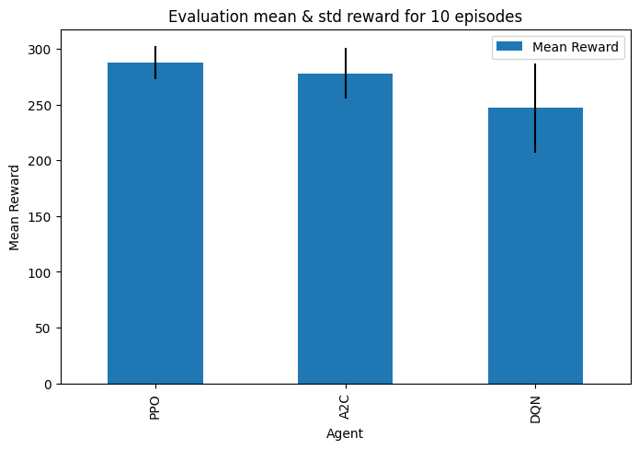
Results: Evaluation

Slide 12
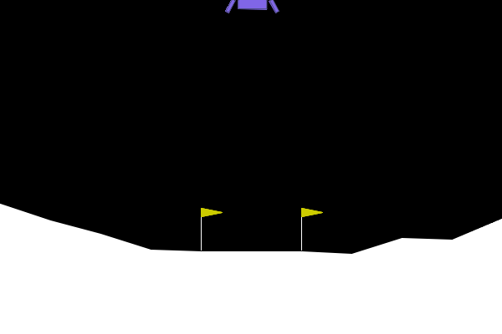
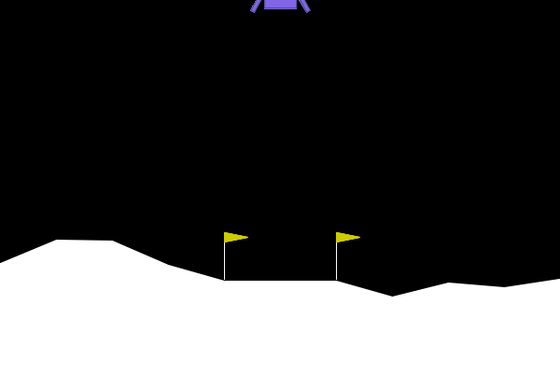
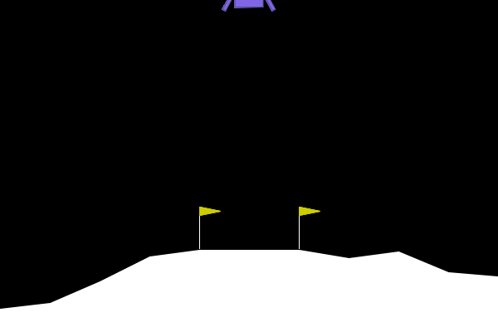
Results: Evaluation rendered
PPO
A2C DQN

Slide 13
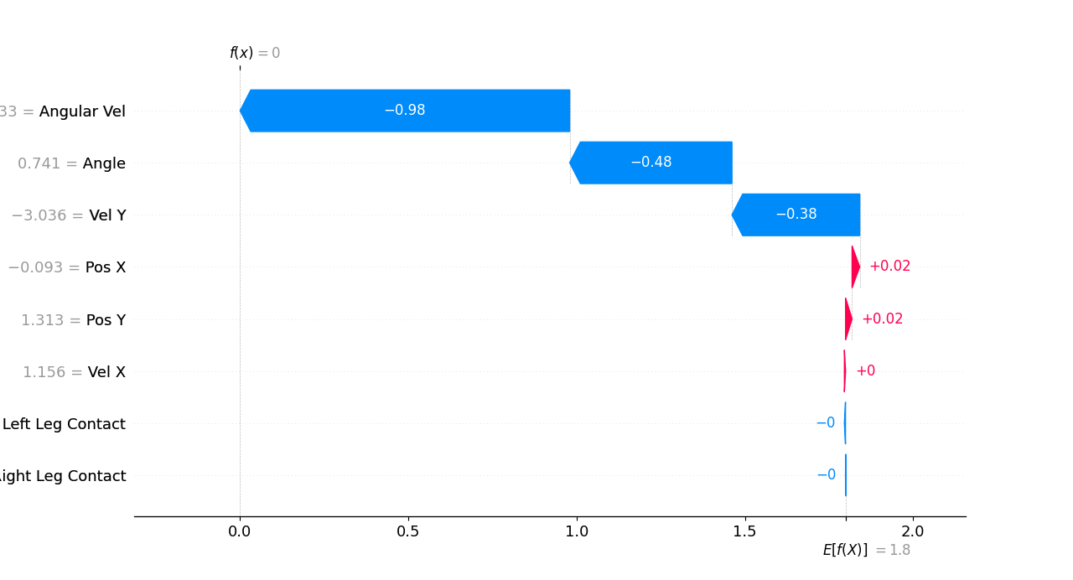
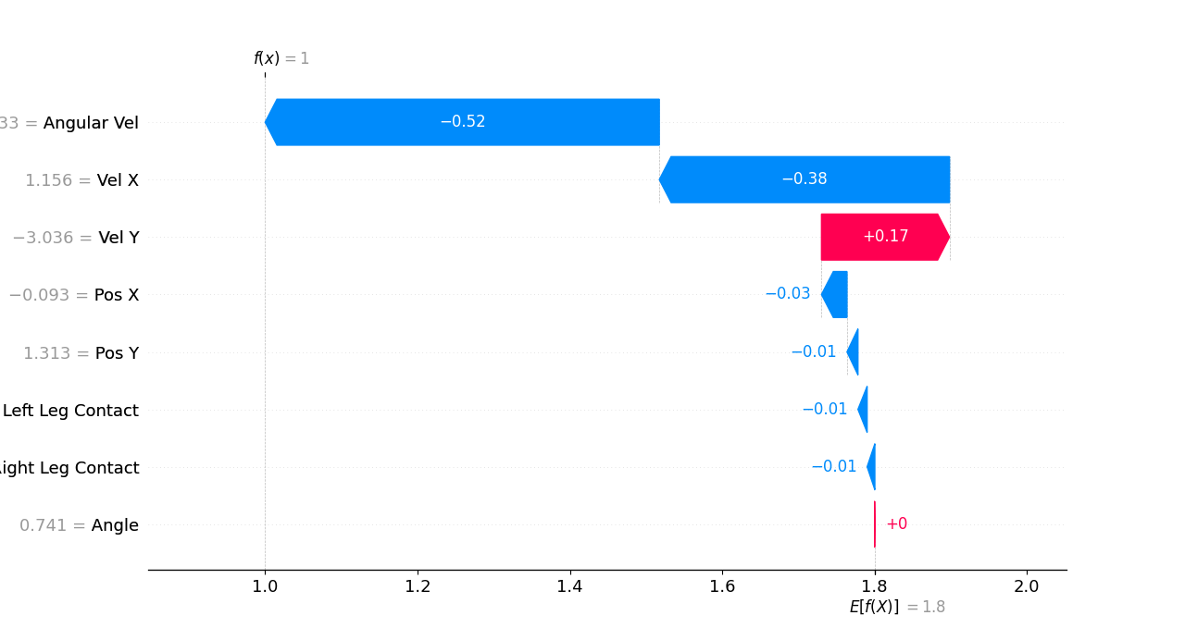
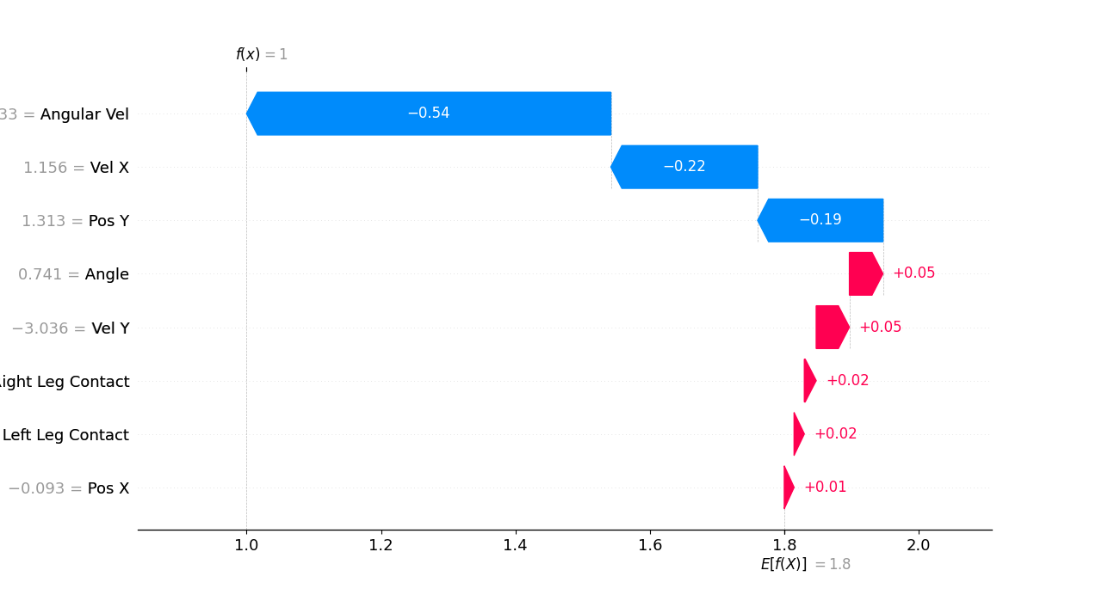
Local SHAP
DQN
A2C
PPO

Slide 14
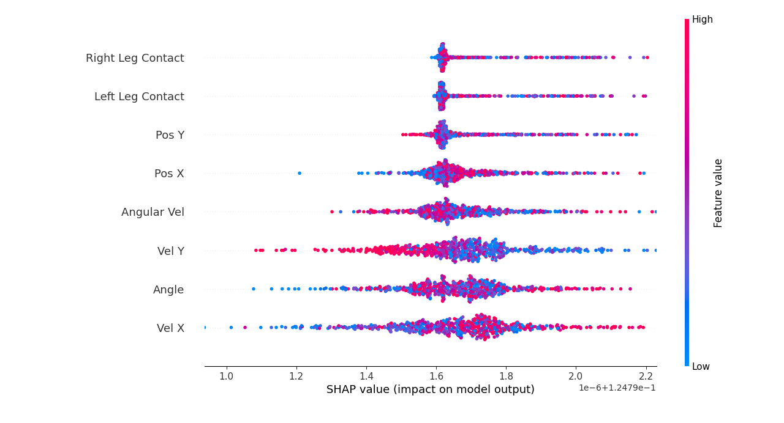
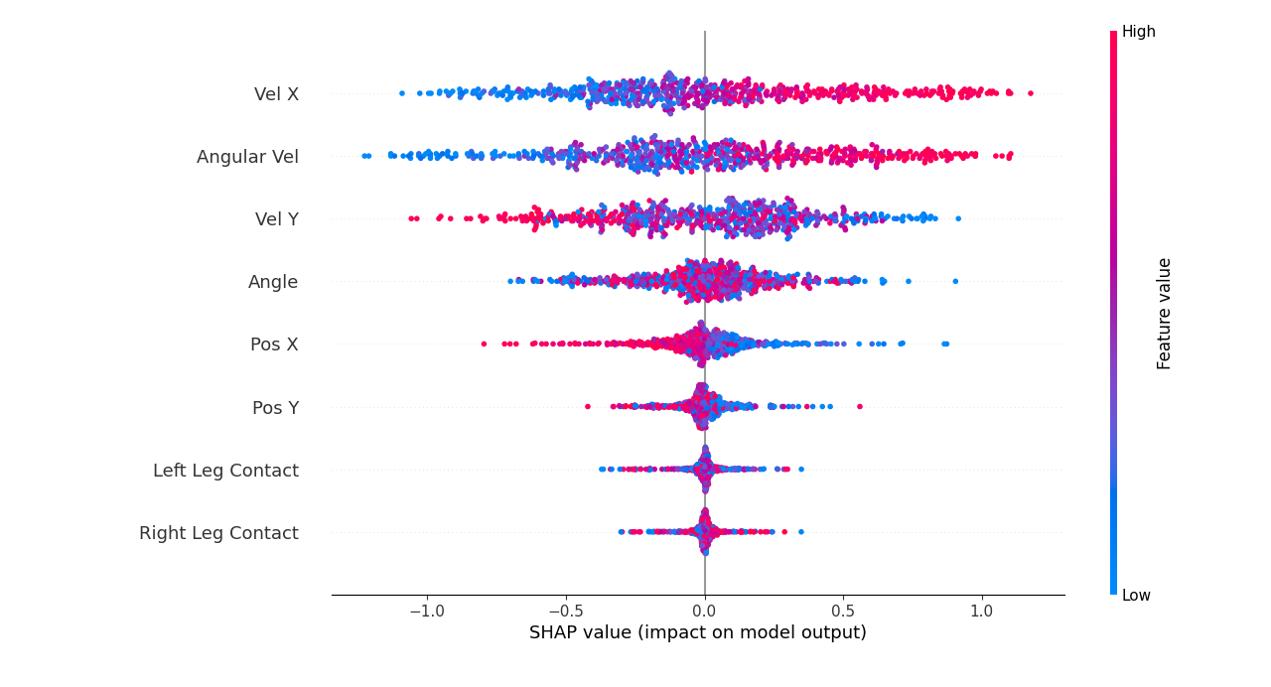
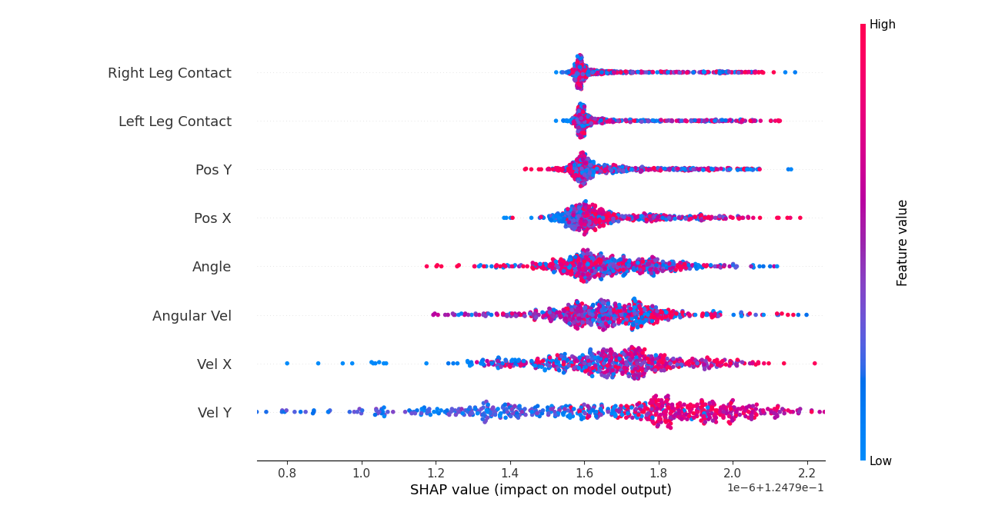
Global SHAP
DQN
A2C
PPO

Slide 15
Conclusion

Slide 16
Q&A

